Slide 1
Flood Risk Model
Urban Road Networks of London
Yingzhe Lei
17 Oct 2024

Slide 2
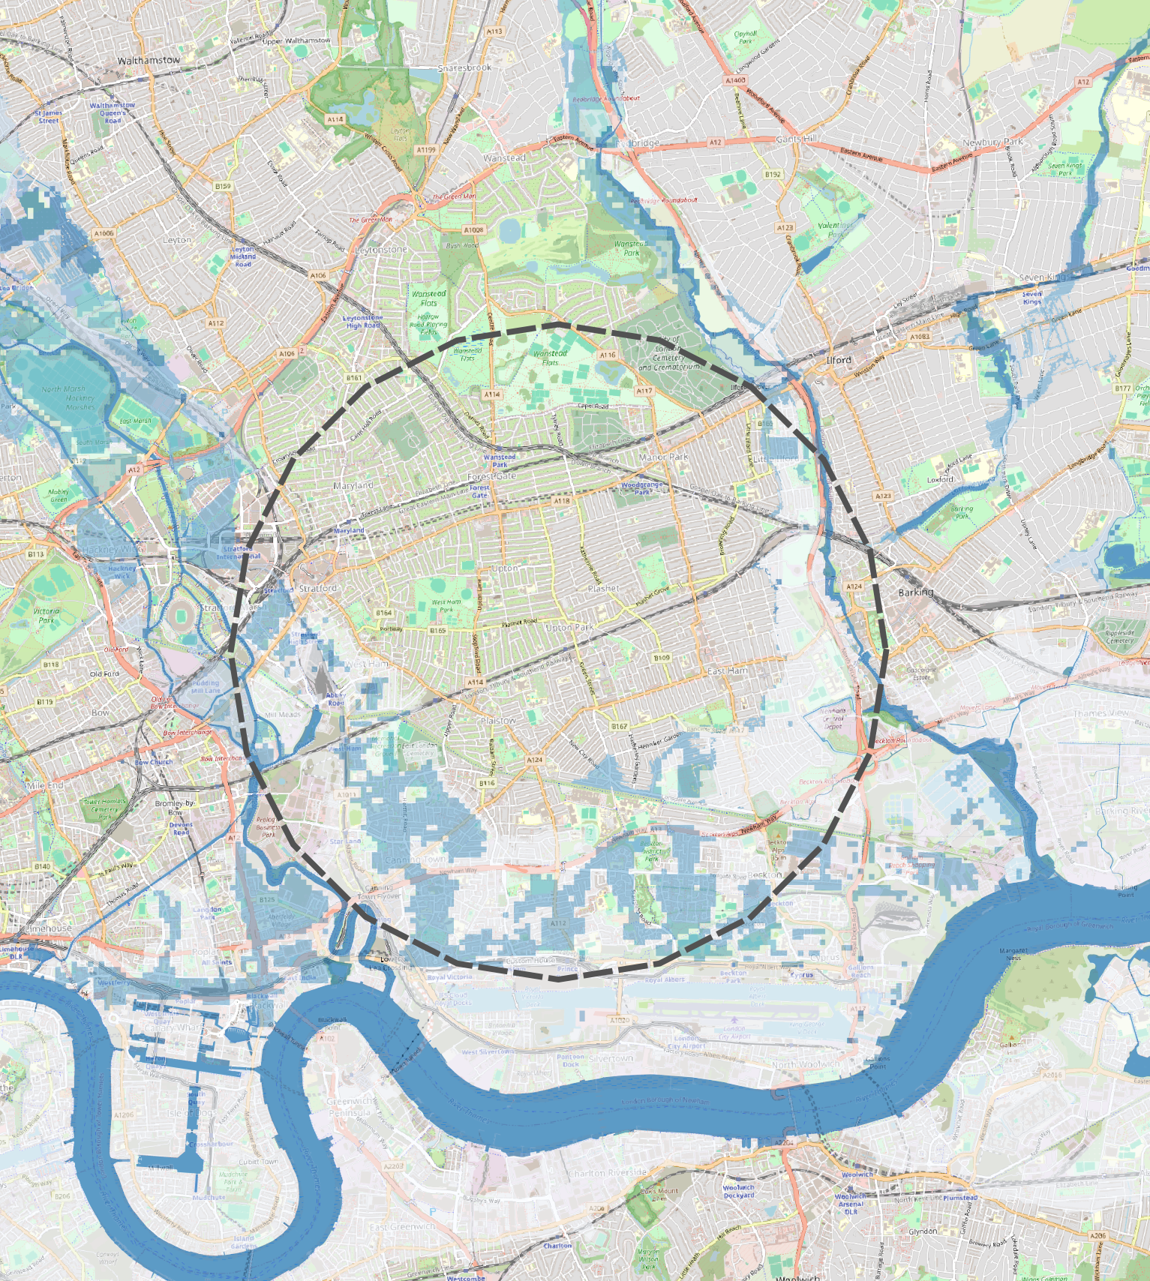
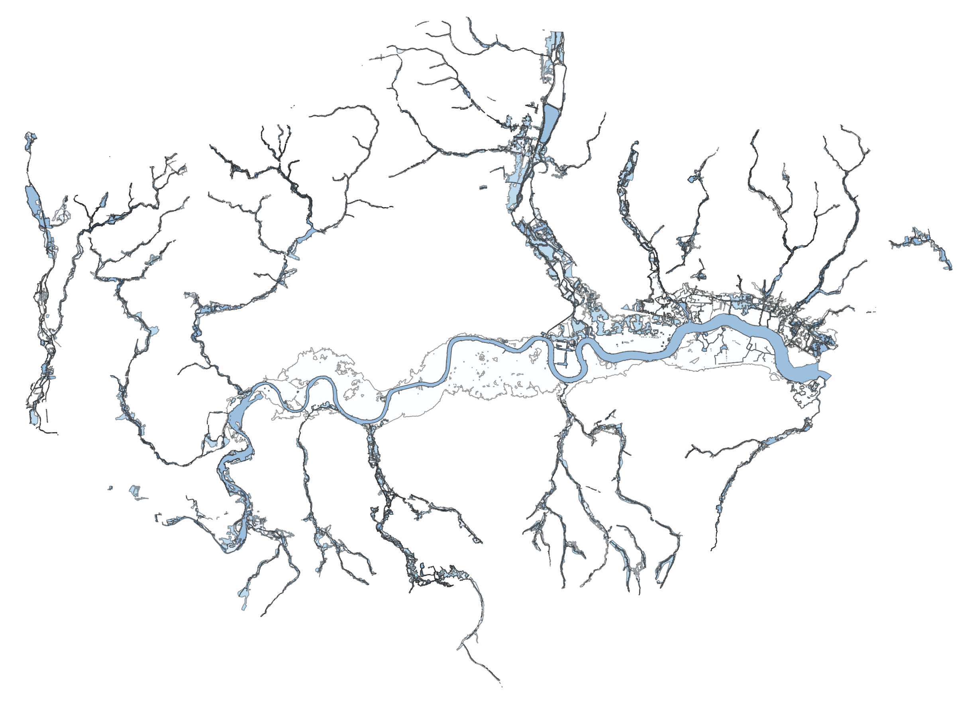
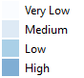
Background and Data
Upton Park Rail Station
01. Risk of flood from rivers and sea
Flood Risk Model
17 October 2024

Slide 3
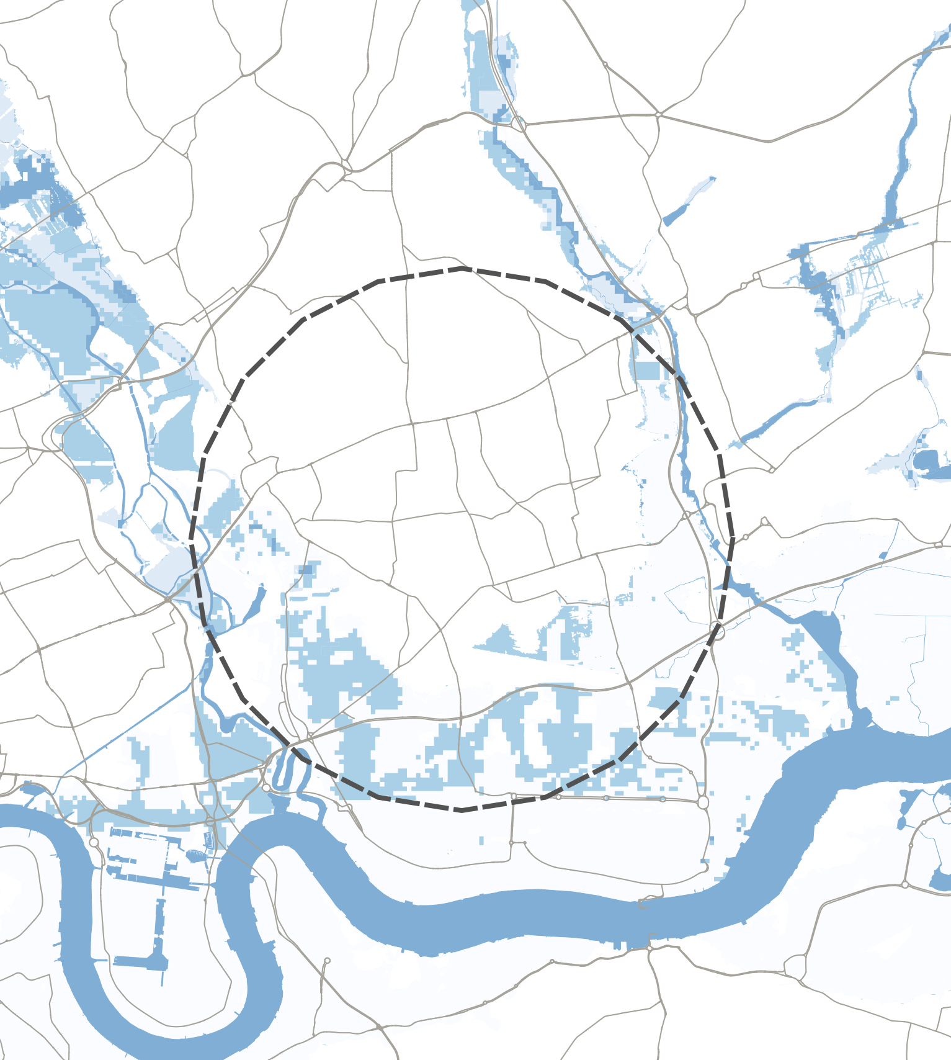
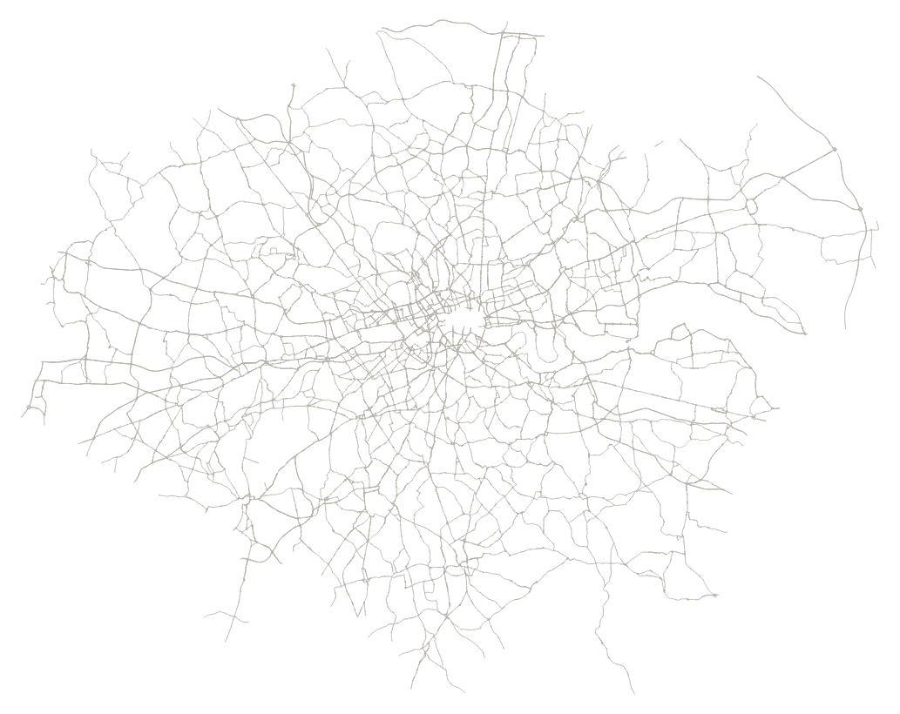
Background and Data
02. London Road network
Flood Risk Model
17 October 2024

Slide 4
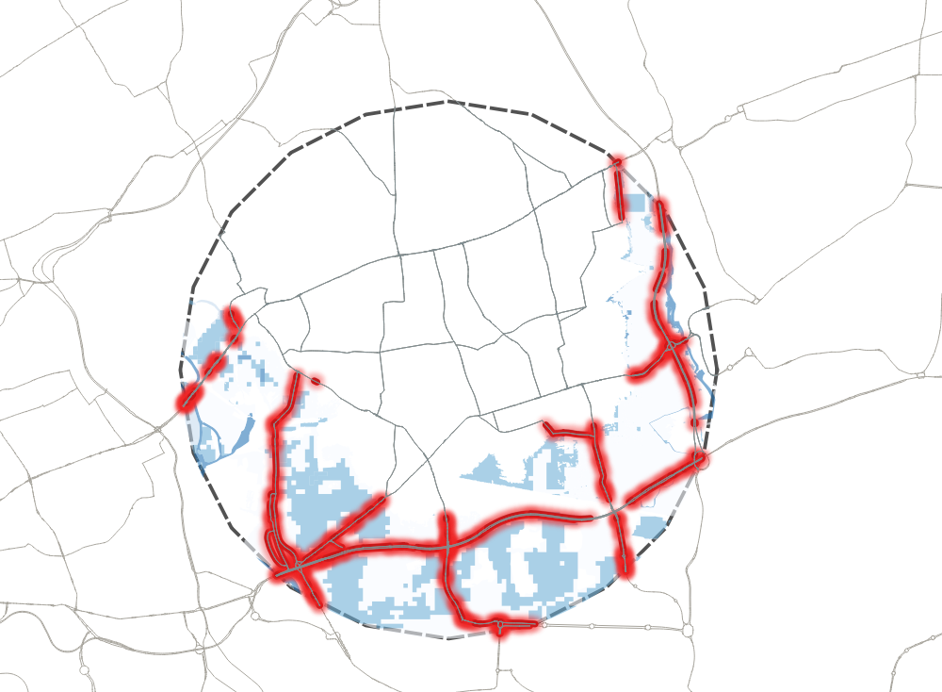
Q1: Which part of the road network will be affected?
Doesn’t show regional risks
Not continuous
Not suitable to risk analysis in larger scale
Flood Risk Model
17 October 2024

Slide 5
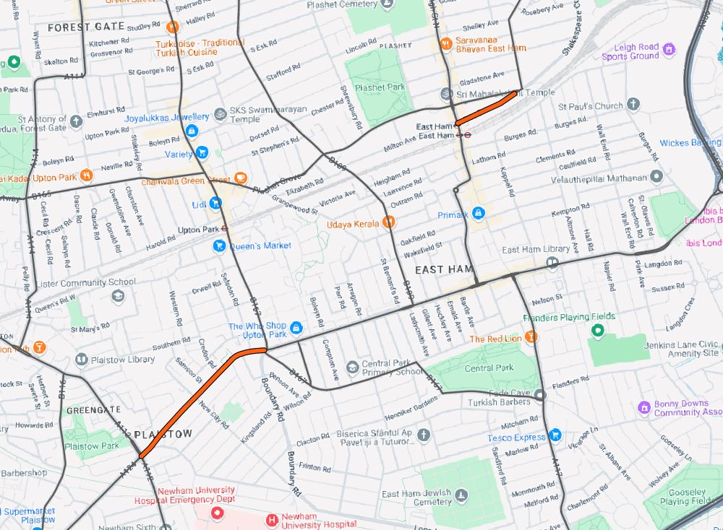
Q2: Are the affected roads critical to the area?
Hierarchy
Road type
Position within a graph
lower criticality
higher criticality
Flood Risk Model
17 October 2024

Slide 6
Model Aims
To produce a metric to reflect regional impact under flood risk
To produce a metric to reflect the vulnerability of the road network
Flood Risk Model
17 October 2024

Slide 7
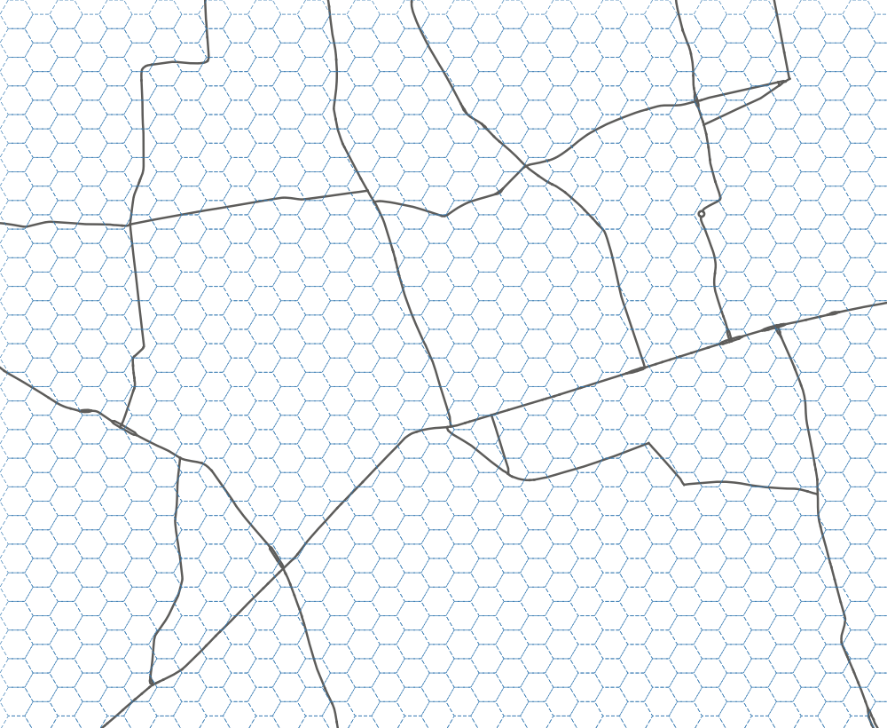


Model Design: Grid Sampling
Hexagonal Grid
Square Grid
Hex sampling points

Slide 8
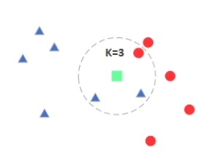
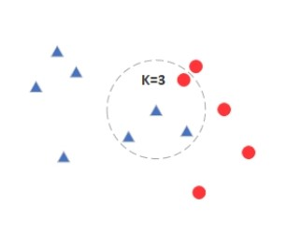
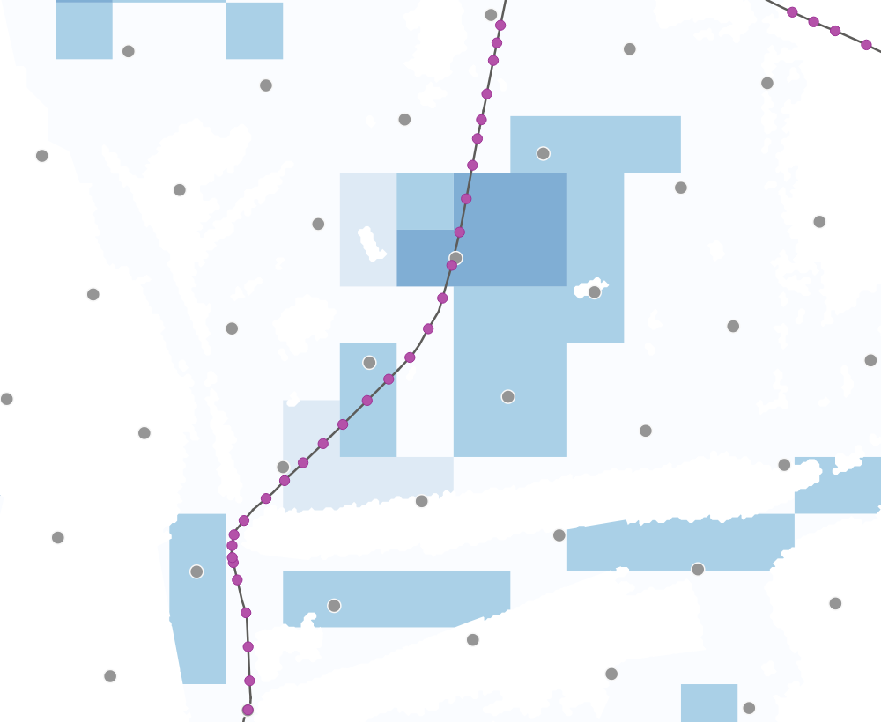
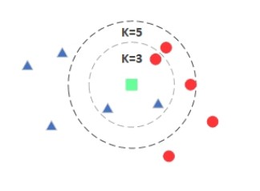
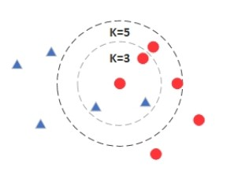
Model Design: K-Nearest Neighbour (KNN)
K=3
K=5

Slide 9
The combination of importance and disruption probability is called the criticality of the element. World Bank Group, Flood Risk in Road Networks
Model Design: Multi-Criteria Analysis
Flooding Probability
Road Vulnerability
Road Resilience
Multi-Criteria Analysis
Risk Score
9
Flood Risk Model
17 October 2024

Slide 10
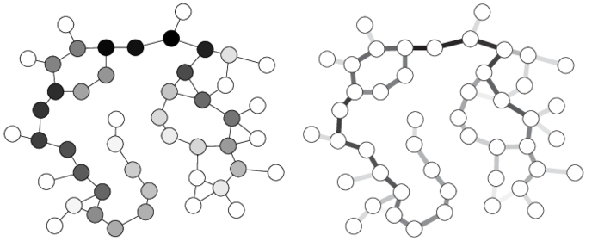
Model Design: Network Metrics
Betweenness
Degree Centrality
Closeness (node)
Closeness (edge)
Importance Measure
Network Robustness Index
Node
Edge
Flood Risk Model
17 October 2024

Slide 11
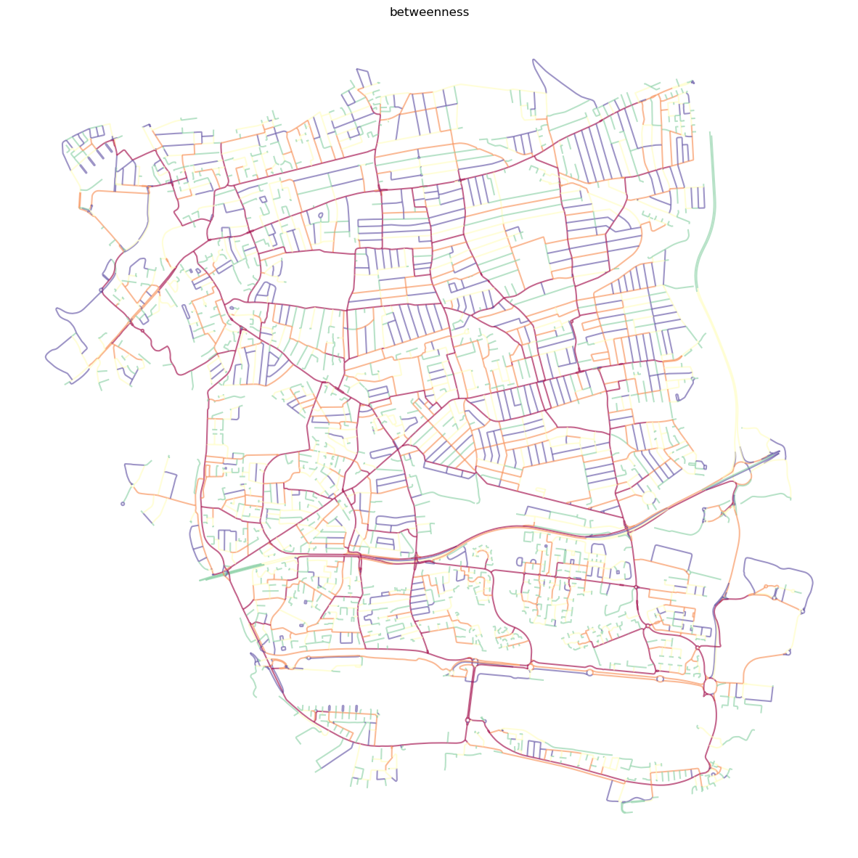

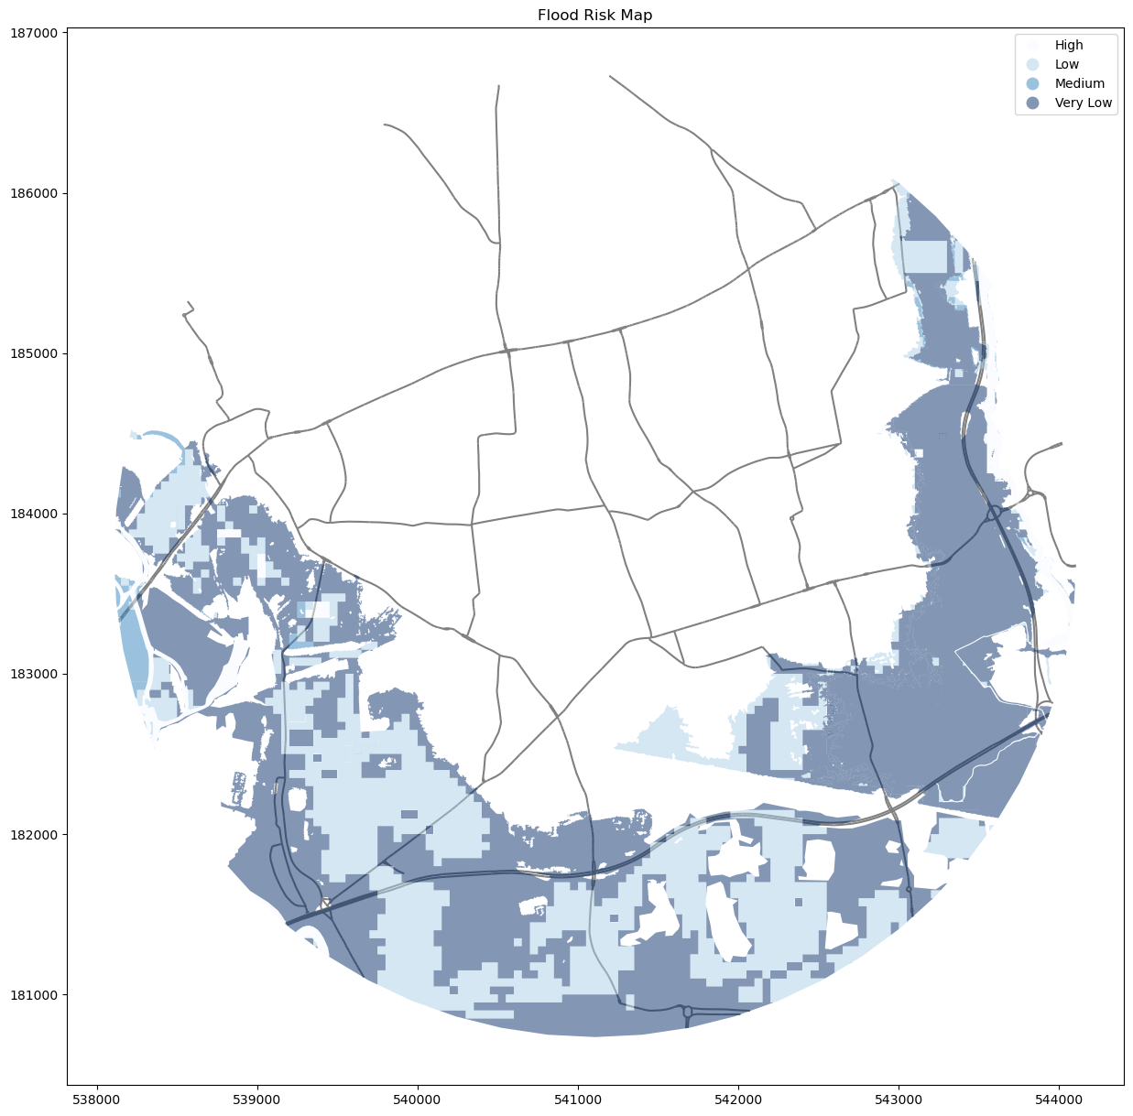
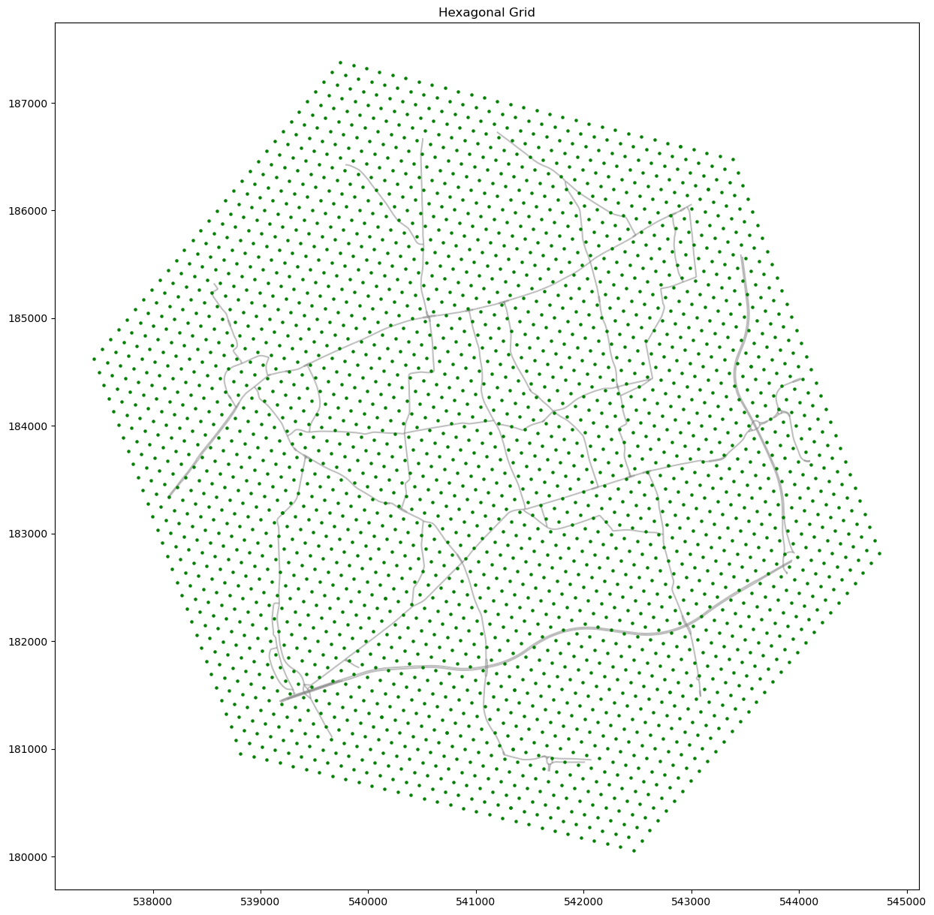
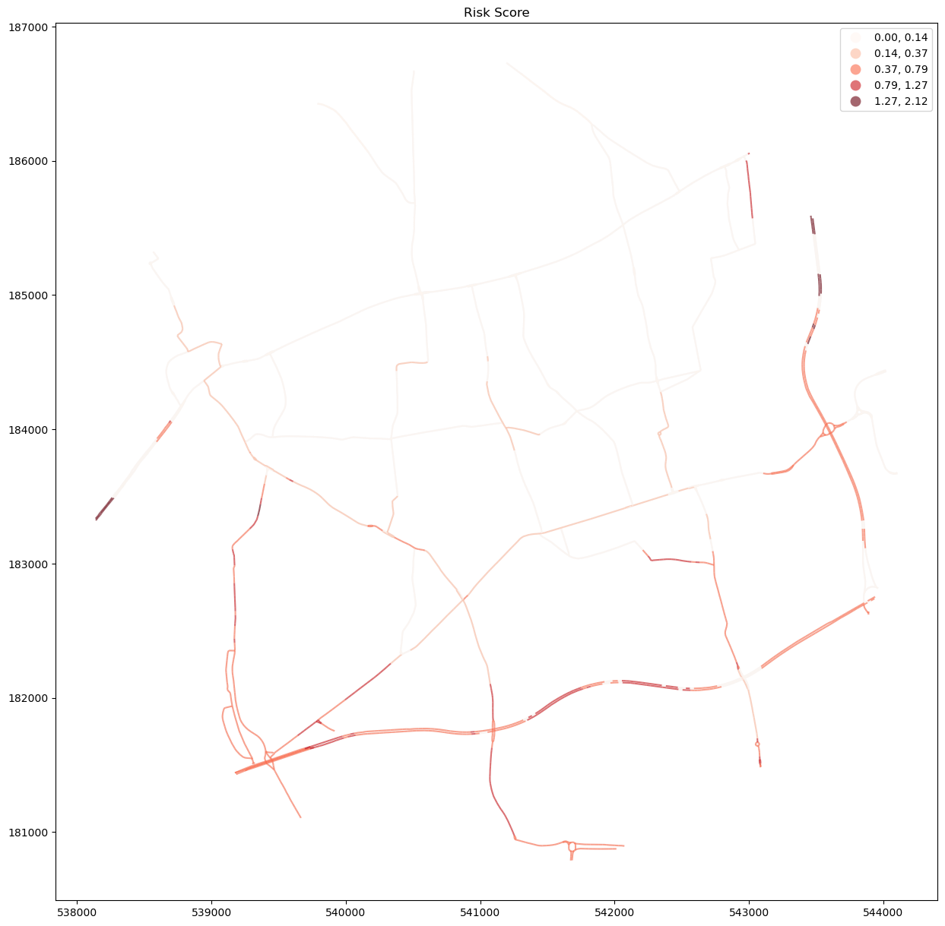
Modelling Process
1. Data Collection & Processing
Data download/request
Clip to study area
Road network segmentation
3. Network Analysis
Build graph through road network
Calculate betweenness for edges
2. Grid Sampling & KNN Classification
4. Risk Score and Visualization
Create hexagonal grid
Flood risk classification through KNN
Flood Risk Model
17 October 2024

Slide 12
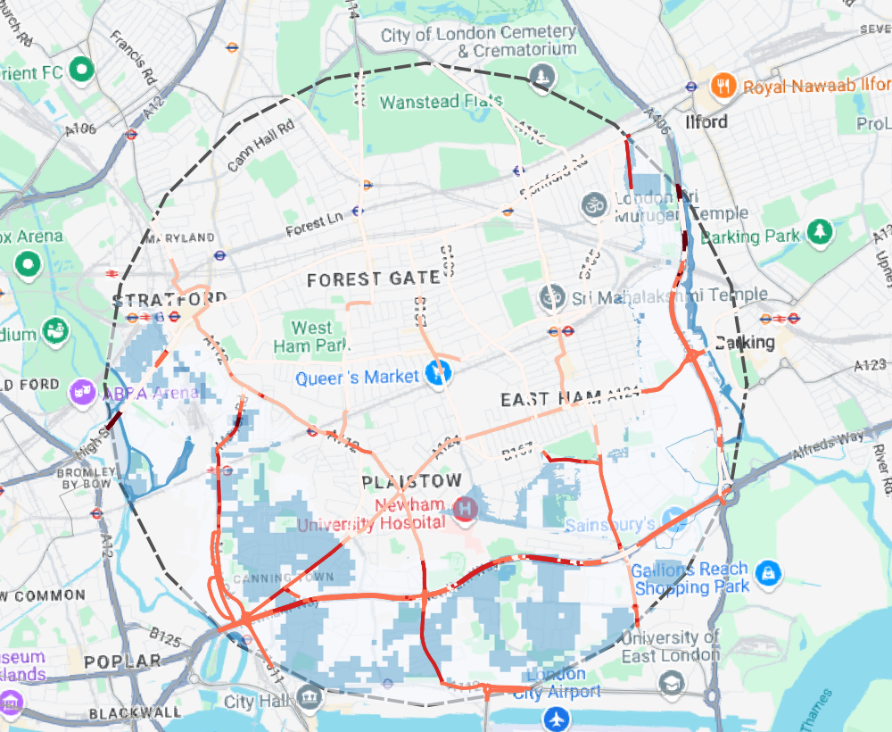
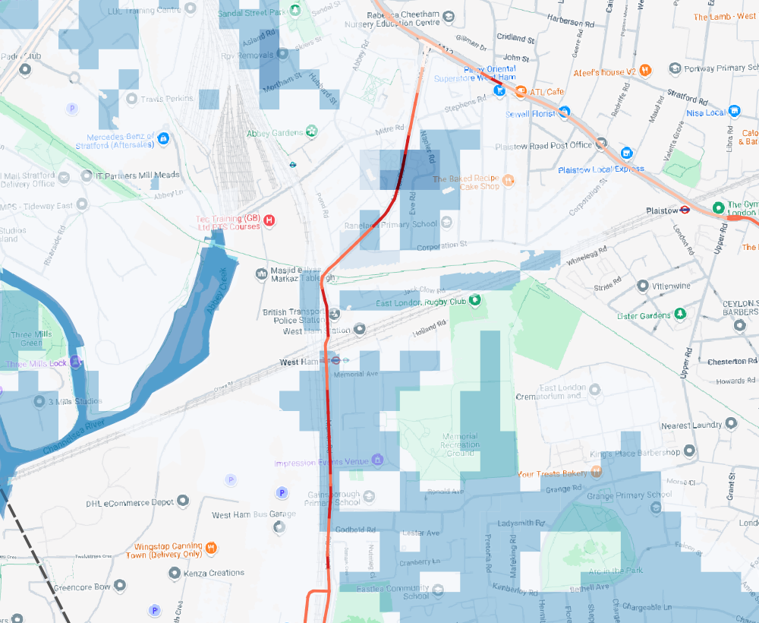
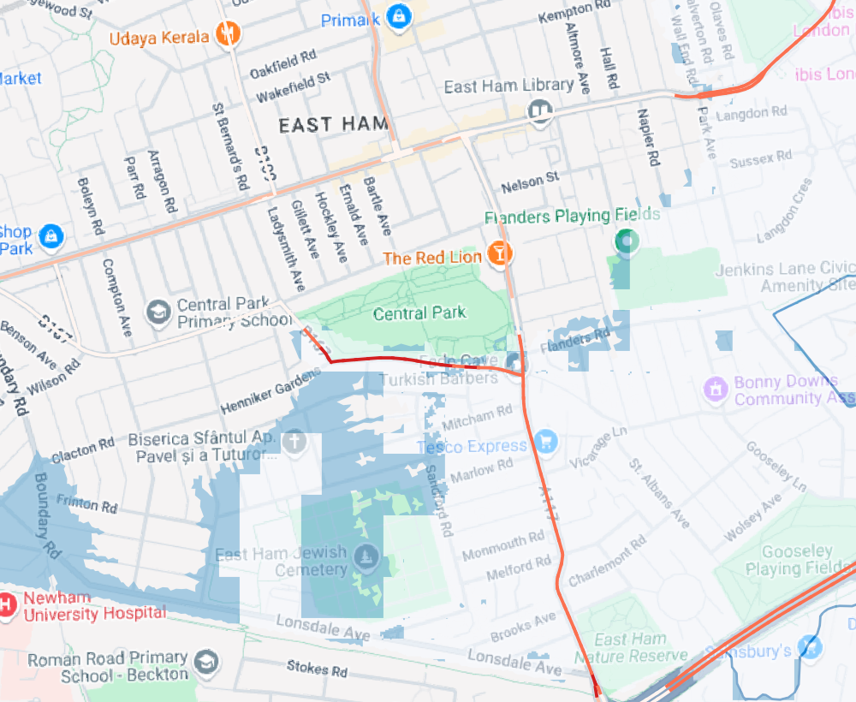
Flood Risk Score

Slide 13
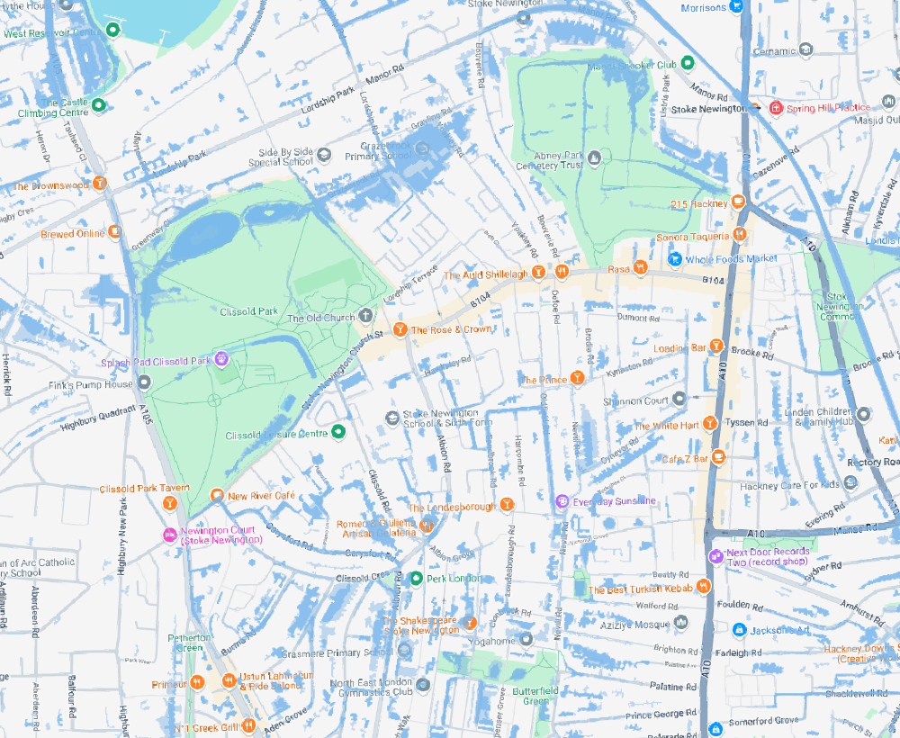
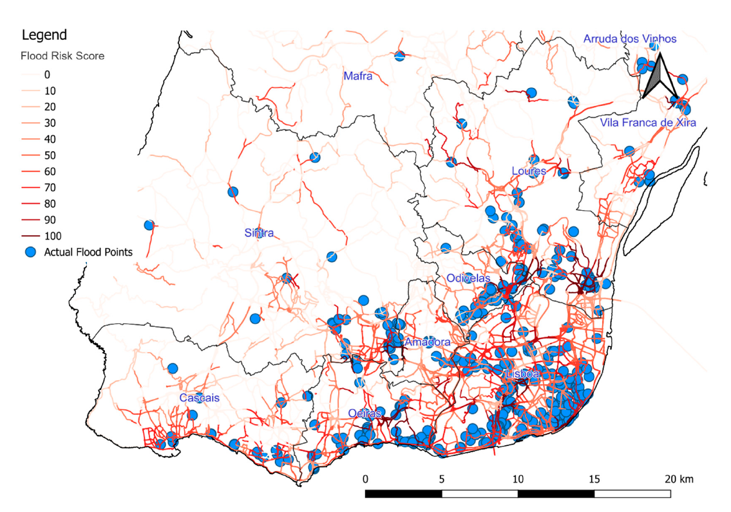
Improvements: Optional Data
Flood Risk Data
Road
Land
Traffic
Age of the infrastructure
Design standard
Land use
Soil permeability
Soil Texture
Stone content type
Flooding from surface water
Topographic
Digital Elevation Model
Slope
Historical flooding events
Flood Risk Model
17 October 2024

Slide 14

Thank you
Yingzhe Lei
yingzhelei@gmail.com

